Slide 1
Module 4 LOADER

Slide 2
FUNCTIONS OF LOADER
Loading - Brings the object program into memory for execution.
Relocation - Modifies the object program so that it can be loaded at an address different from the location originally specified.
Linking - Combines two or more separate object programs and supplies the information needed to allow references between them.

Slide 3
Only loading:- Absolute loader
loading + relocation:- relocating loader
Loading + relocation +linking :-linking loader
Linking only:- linker

Slide 4
4.1 BASIC LOADER FUNCTIONS
Fundamental functions of a loader:
1. Bringing an object program into memory.
2. Starting its execution.

Slide 5
4.1.1 Design of an Absolute Loader
No linking and program relocation is needed
For a simple absolute loader, all functions are accomplished in a single pass as follows:
The Header record of object programs is checked to verify that the correct program has been presented for loading.
As each Text record is read, the object code it contains is moved to the indicated address in memory.
When the End record is encountered, the loader jumps to the specified address to begin execution of the loaded program.

Slide 6
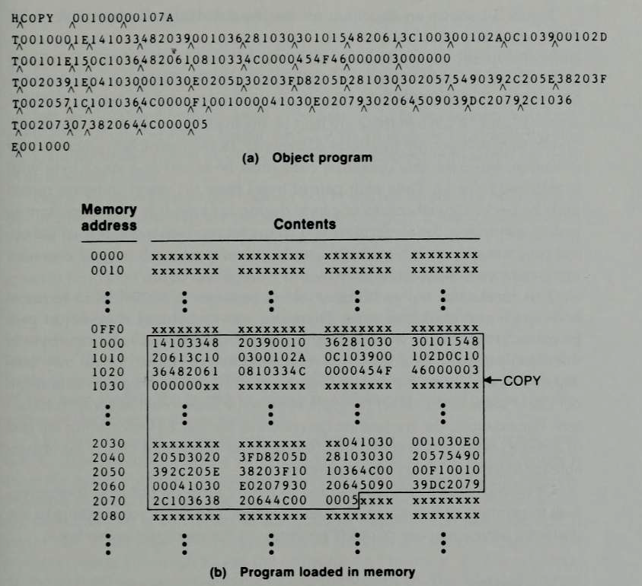
Figure 4.1 Loading of an absolute program
Notes:
Last address 1000f

Slide 7
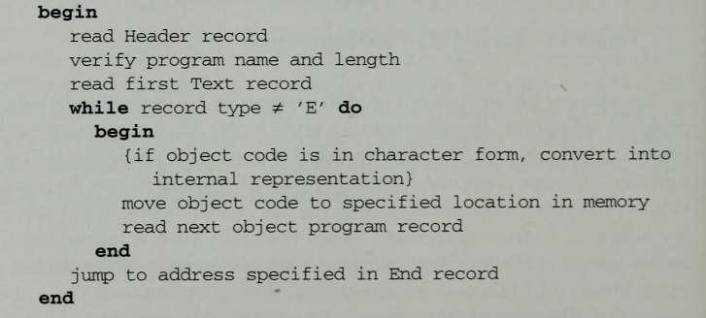
Figure 4.2 Algorithm for an absolute loader

Slide 8
In the object program 4.1(a) each byte of the assembled code is given using its hexadecimal representation in character form
For eg: The machine opcode for STL would be represented by the characters “1” and “4”.
When these are read by the loader, they will occupy 2 bytes of memory.
In the instruction as loaded for execution, this operation code must be stored in a single byte with hexadecimal value 14.
Thus each pair of bytes from the object program must be packed together into a single byte during loading

Slide 9
It is very important to realize that in Fig 4.1 (a), each printed character represents one byte of the object program record.
In Fig 4.1(b), on the other hand, each printed character represents one hexadecimal digit in memory (a half-byte).
Therefore, to save space and execution time of loaders, most machines store object programs in a binary form, with each byte of object code stored as a single byte in the object program.
In this type of representation a byte may contain any binary value.

Slide 10
4.1.2 A Simple Bootstrap Loader
Special type of Absolute loader
It loads the very first pgm, required by the computer and begins execution
OS
It is an absolute loader that loads operating system into memory for execution

Slide 11
When a computer is first turned on or restarted, a special type of absolute loader, called a bootstrap loader, is executed.
This bootstrap loads the first program to be run by the computer – usually an operating system.

Slide 12
Working of a simple Bootstrap loader
Bootstrap loader itself is a PGM
The bootstrap begins at address 0 in the memory of the machine.
It loads the operating system at address 80.
There is no Header Record, Text Record or Control Record

Slide 13
OS program to be loaded
17202D48 470012XX XX…….
.
.
.
2010110C 1039XXX………

Slide 14
Problem of Reading OS pgm
While reading the object Pgm it consider each digit of the object code as a character
So every character occupies 1 byte instead of half bytes
Every object code is a hexadecimal digit
It needs a half bye memory

Slide 15
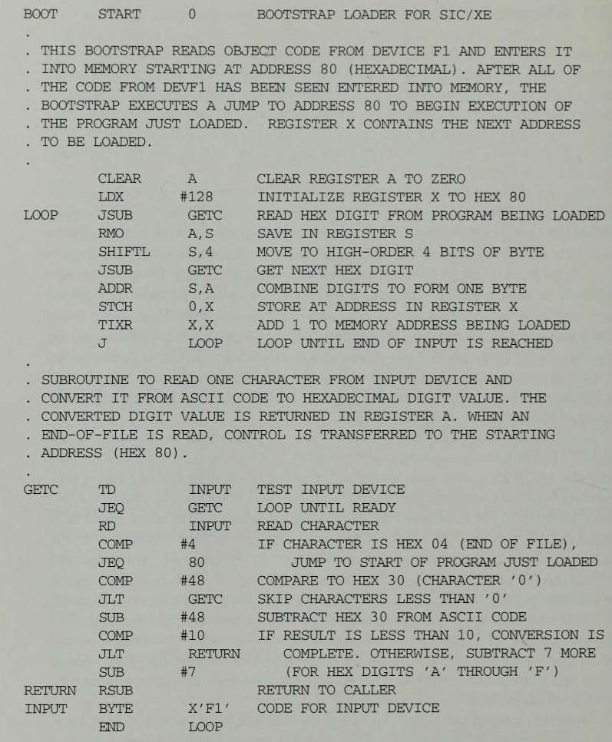
Figure 4.3 Bootstrap loader for SIC/XE

Slide 16
BOOT is the program name
It is available at address 0
It loads the OS into the address 80

Slide 19
Each byte of object code to be loaded is represented on device F1 as two hexadecimal digits just as it is in a Text record of a SIC object program.
The object code from device F1 is always loaded into consecutive bytes of memory, starting at address 80.
The main loop of the bootstrap keeps the address of the next memory location to be loaded in register X.
After all of the object code from device F1 has been loaded, the bootstrap jumps to address 80, which begins the execution of the program that was loaded.

Slide 20
Much of the work of the bootstrap loader is performed by the subroutine GETC.
This subroutine reads one character from device F1 and converts it from the ASCII character code to the value of the hexadecimal digit that is represented by that character.
For eg:
ASCII code for character “0” is converted to numerical value 0.
Similarly ASCII code for characters “1 “through “9”(hexadecimal 31 through 39) are converted to numeric values 1 through 9.
This is done by subtracting 48 (hex 30)from the character codes for 0 through 9.
Similarly ASCII code for “A” through “F” (hexadecimal 41 through 46)are converted to the values 10 through 15 by subtracting 55 (hex 37)from the codes for A through F.
It skips all the other input characters that have ASCII codes less than 48(hexadecimal 30)

Slide 21
The main loop of the bootstrap keeps the address of the next memory location to be loaded in register X.
GETC is used to convert a pair of characters from device F1(representing 1 byte of object code to be loaded).
These two hexadecimal digit values are combined into a single byte by shifting the first one left 4 bit positions and adding the second to it.
The resulting byte is stored at the address currently in X, using a STCH instruction that refers to location 0 using indexed addressing.
The TIXR instruction is then used to add 1 to the value in register X.

Slide 22
4.2 MACHINE-DEPENDENT LOADER FEATURES
The absolute loader is simple and efficient. But it has several potential disadvantages.
One of the most obvious is the need for the programmer to specify the actual address at which it will be loaded into memory.
On a simple computer with a small memory the actual address at which the program will be loaded can be specified easily.
On a larger and more advanced machine, we often like to run several independent programs together, sharing memory between them. We do not know in advance where a program will be loaded. Hence we write relocatable programs instead of absolute ones.
Writing absolute programs also makes it difficult to use subroutine libraries efficiently. This could not be done effectively if all of the subroutines had preassigned absolute addresses.

Slide 23
The need for program relocation is an indirect consequence of the change to larger and more powerful computers.
The way relocation is implemented in a loader is also dependent upon machine characteristics.

Slide 24
4.2.1 Relocation
Loaders that allow for program relocation are called relocating loaders or relative loaders.
Two methods for specifying relocation as part of the object program:
The first method :
A Modification is used to describe each part of the object code that must be changed when the program is relocated.
Most of the instructions in this program use relative or immediate addressing.
The only portions of the assembled program that contain actual addresses are the extended format instructions on lines 15, 35, and 65. Thus these are the only items whose values are affected by relocation .

Slide 25
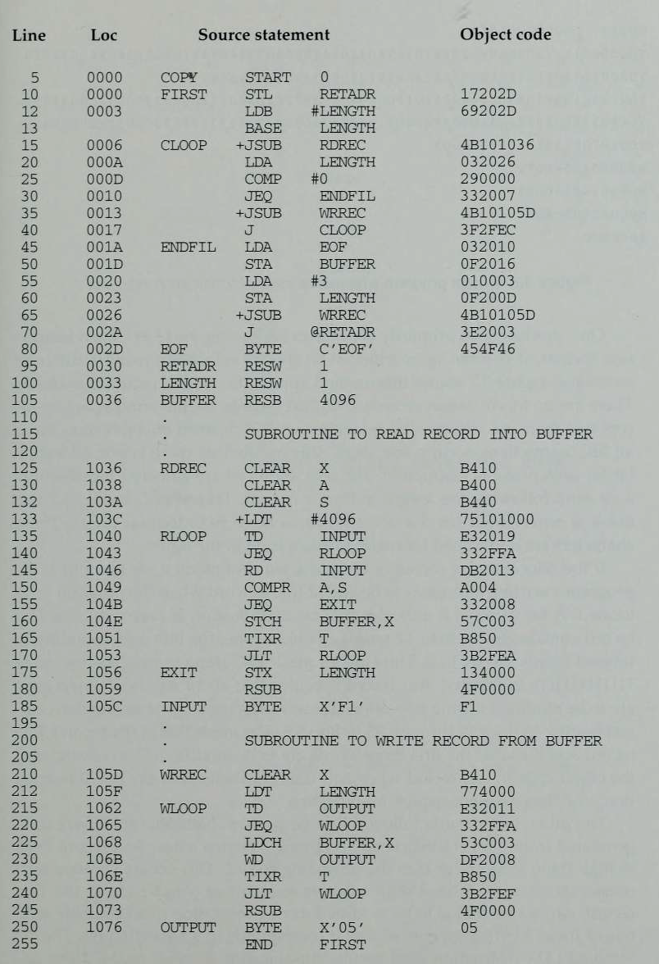

Slide 26
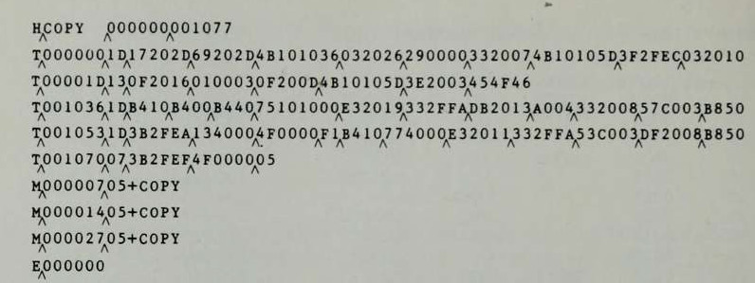

Slide 27
Each Modification record specifies the starting address and length of the field whose value is to be altered.
It then describes the modification to be performed.
In this example, all modifications add the value of the symbol COPY, which represents the starting address of the program.

Slide 28
The Modification record is not well suited for use with all machine architectures.
Consider, for example, the program in figure(standard SIC program) .This is a relocatable program written for standard version for SIC.
The standard SIC machine does not use relative addressing.
In this program the addresses in all the instructions except RSUB must modified when the program is relocated. This would require 31 Modification records which results in an object program more than twice as large as the one in SIC/XE object program.

Slide 29
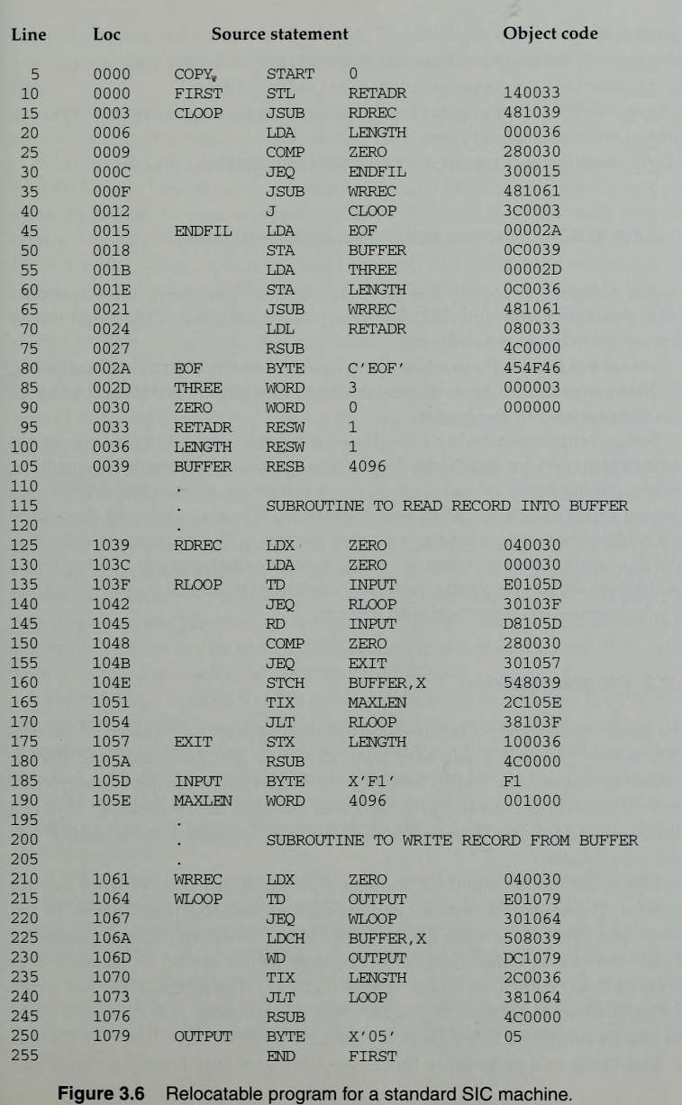

Slide 30
The second method :
In the case of a machine that primarily uses direct addressing(SIC) and has a fixed instruction format, relocation is specified using a different technique.
There are no Modification records.
The Text records are the same as before except that there is a relocation bit associated with each word of object code.
Since all SIC instructions occupy one word, this means that there is one relocation bit for each possible instruction.
The relocation bits are gathered together into a bit mask following the length indicator in each Text record. In Figure this mask is represented (in character form) as three hexadecimal digits.
If the relocation bit corresponding to a word of object code is set to 1, the program’s starting address is to be added to this word when the program is relocated. A bit value of 0 indicates that no modification is necessary.
If a Text record contains fewer than 12 words of object code, the bits corresponding to unused words are set to 0.

Slide 31
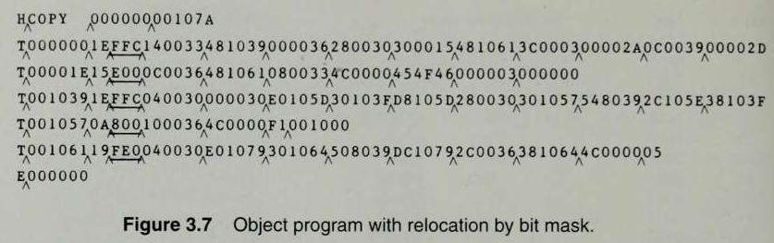

Slide 32
For example, the bit mask FFC (representing the bit string 111111111100) in the first Text record specifies that all 10 words of object code are to be modified during relocation.

Slide 33
4.2.2 Program Linking
Consider the three (separately assembled) programs in the figure, each of which consists of a single control section.

Slide 34
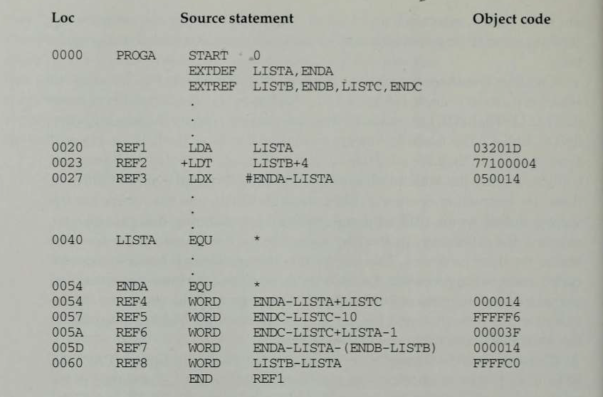

Slide 35
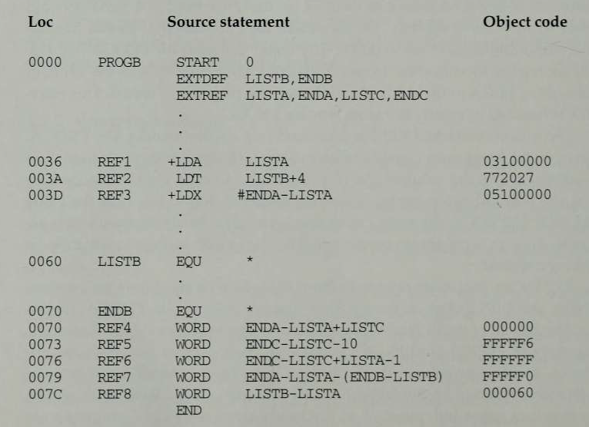

Slide 36
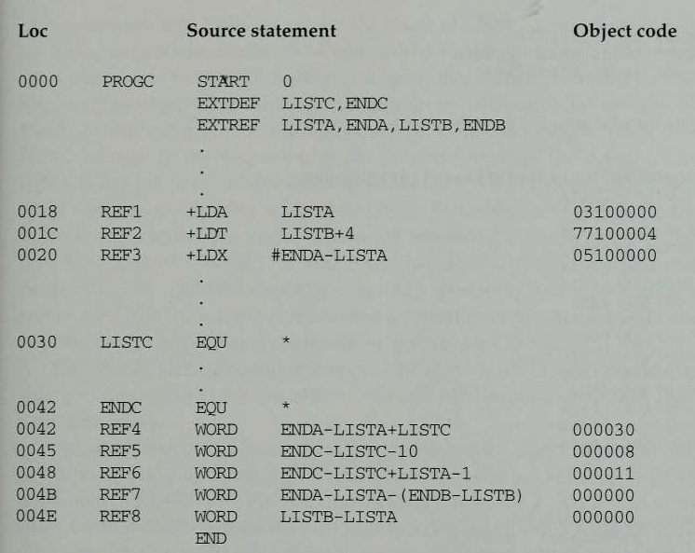

Slide 37
Consider first the reference marked REF1.
For the first program (PROGA), REF1 is simply a reference to a label within the program.
It is assembled in the usual way as a PC relative instruction.
No modification for relocation or linking is necessary.
In PROGB, the same operand refers to an external symbol.
The assembler uses an extended-format instruction with address field set to 00000.
The object program for PROGB contains a Modification record instructing the loader to add the value of the symbol LISTA to this address field when the program is linked.
For PROGC, REF1 is handled in exactly the same way.

Slide 38
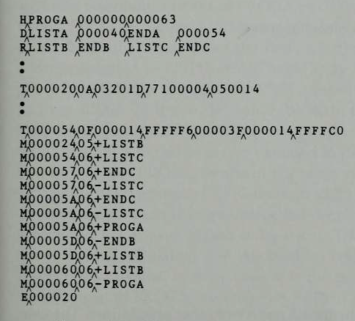

Slide 39
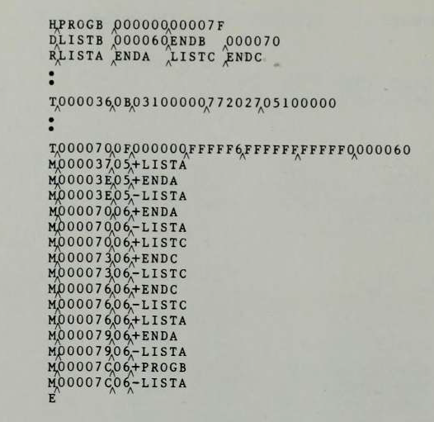

Slide 40
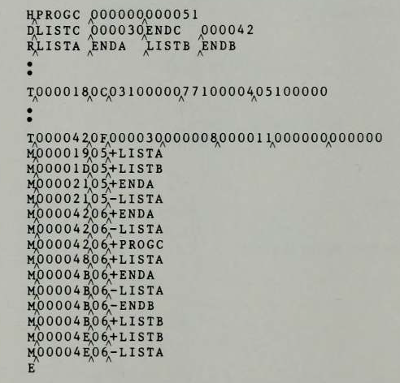

Slide 41
The reference marked REF2 is processed in a similar manner.
REF3 is an immediate operand whose value is to be the difference between ENDA and LISTA (that is, the length of the list in bytes).
In PROGA, the assembler has all of the information necessary to compute this value.
During the assembly of PROGB (and PROGC), the values of the labels are unknown.
In these programs, the expression must be assembled as an external reference (with two Modification records) even though the final result will be an absolute value independent of the locations at which the programs are loaded.

Slide 42
Consider REF4.
The assembler for PROGA can evaluate all of the expression in REF4 except for the value of LISTC. This results in an initial value of ‘000014’H and one Modification record.
The same expression in PROGB contains no terms that can be evaluated by the assembler. The object code therefore contains an initial value of 000000 and three Modification records.
For PROGC, the assembler can supply the value of LISTC relative to the beginning of the program (but not the actual address, which is not known until the program is loaded).
The initial value of this data word contains the relative address of LISTC (‘000030’H).
Modification records instruct the loader to add the beginning address of the program (i.e., the value of PROGC), to add the value of ENDA, and to subtract the value of LISTA.

Slide 43
PROGA has been loaded starting at address 4000, with PROGB and PROGC immediately following.
For example, the value for reference REF4 in PROGA is located at address 4054 (the beginning address of PROGA plus 0054).

Slide 44
 | Starting address | Pgm length | Ending address
PGM A | 4000 | 0063 | 4062
PGM B | 4063 | 007F | 40E2
PGM C | 40E3 | 0051 | 4133

Slide 45
CONTROL SECTION | SYMBOL NAME | ADDRESS | LENGTH
PGM A | LISTA ENDA | 4000 4040 4054 | 0063
PGM B | LISTB ENDB | 4063 40C3 40D3 | 007F
PGM C | LISTC ENDC | 40E2 4112 4124

Slide 46
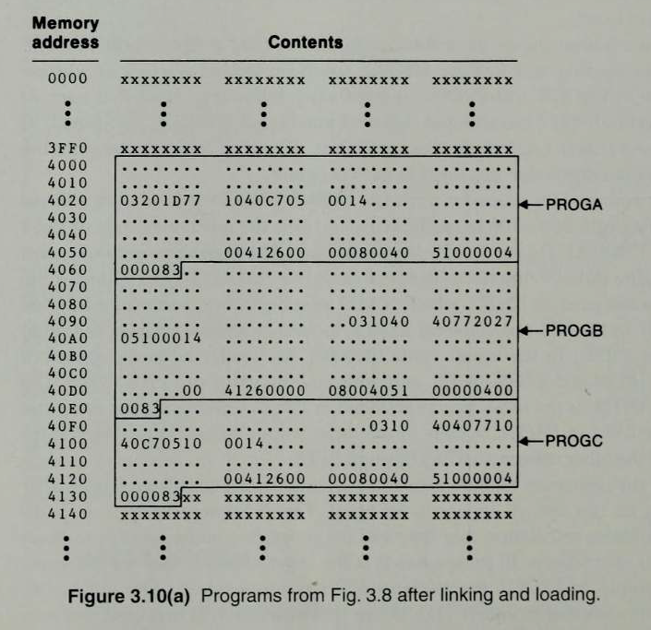

Slide 47
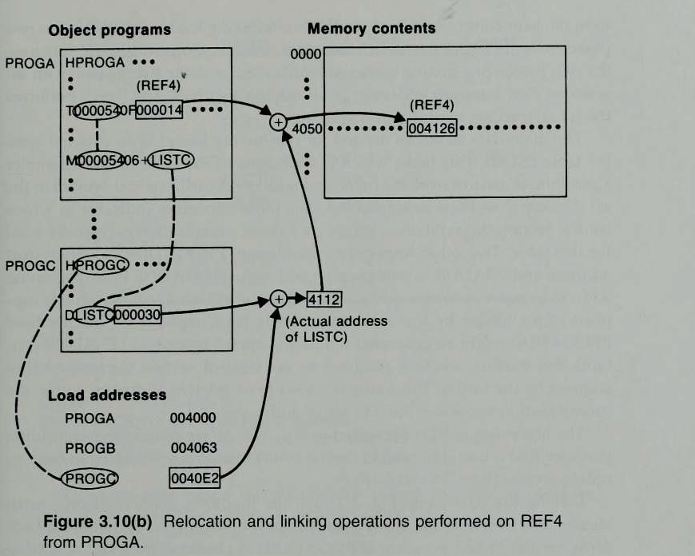
The initial value (from the Text record) is 000014. To this is added the address assigned to LISTC, which 4112 (the beginning address of PROGC plus 30).

Slide 48
4.2.3 Algorithm and Data Structures for a Linking Loader
The algorithm for a linking loader is considerably more complicated than the absolute loader algorithm.
The input consists of a set of object programs(i.e. control sections) that are to be linked together.
Control section can make external reference to symbols. The linking operation cannot be performed until an address is assigned to the external symbol involved.

Slide 49
Hence a linking loader usually makes two passes over its input, just as an assembler does.
In terms of general function, the two passes of a linking loader are quite similar to the two passes of an assembler:
Pass 1 assigns addresses to all external symbols.
Pass 2 performs the actual loading, relocation, and linking.
The main data structure needed for our linking loader is an external symbol table ESTAB

Slide 50
ESTAB
This table, which is analogous to SYMTAB in our assembler algorithm, is used to store the name and address of each external symbol in the set of control sections being loaded.
The table also indicates in which control section the symbol is defined.
A hashed organization is typically used for this table.
Two other important variables are PROGADDR (program load address) and CSADDR (control section address).
PROGADDR is the beginning address in memory where the linked program is to be loaded. Its value is supplied to the loader by the OS.
CSADDR contains the starting address assigned to the control section currently being scanned by the loader. This value is added to all relative addresses within the control section to convert them to actual addresses.

Slide 51
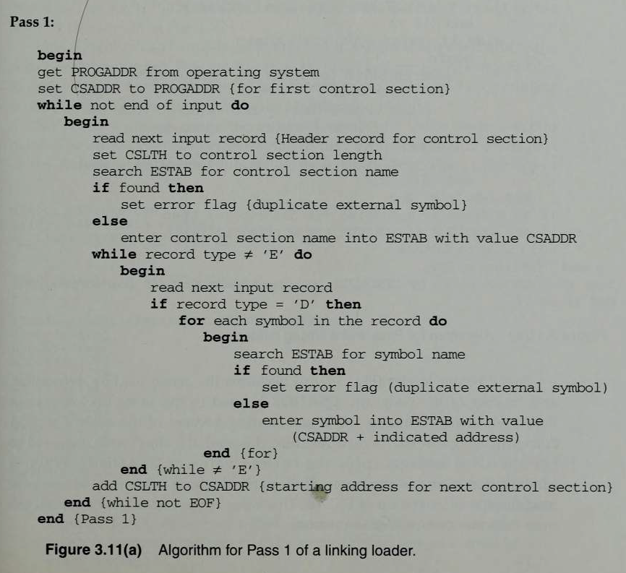

Slide 52
During Pass 1, the loader is concerned only with Header and Define record types in the control sections.
The beginning load address for the linked program (PROGADDR) is obtained from the OS.
This becomes the starting address (CSADDR) for the first control section in the input sequence.

Slide 53
The control section name from Header record is entered into ESTAB, with value given by CSADDR.
All external symbols appearing in the Define record for the control section are also entered into ESTAB.
Their addresses are obtained by adding the value specified in the Define record to CSADDR.

Slide 54
When the End record is read,
the control section length CSLTH (which was saved from the End record) is added to CSADDR.
This calculation gives the starting address for the next control section in sequence.

Slide 55
At the end of Pass 1, ESTAB contains all external symbols defined in the set of control sections together with the address assigned to each.
Many loaders include as an option the ability to print a load map that shows these symbols and their addresses

Slide 56
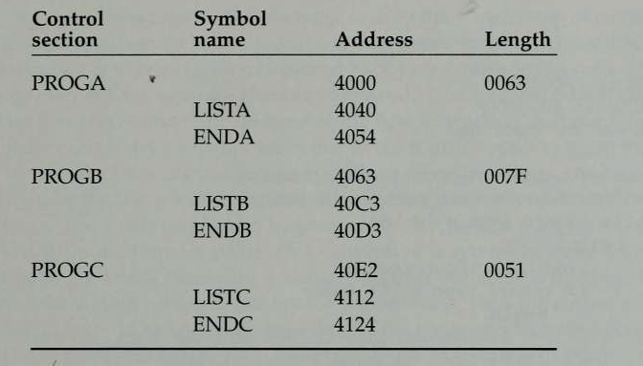

Slide 57
Pass 2 performs the actual loading, relocation, and linking of the program.
As each Text record is read, the object code is moved to the specified address (plus the current value of CSADDR).
When a Modification record is encountered, the symbol whose value is to be used for modification is looked up in ESTAB.
This value is then added to or subtracted from the indicated location in memory.
The last step performed by the loader is usually the transferring of control to the loaded program to begin execution.

Slide 58
The End record for each control section may contain the address of the first instruction in that control section to be executed.
Our loader takes this as the transfer point to begin execution.
If more than one control section specifies a transfer address, the loader arbitrarily uses the last one encountered.
If no control section contains a transfer address, the loader uses the beginning of the linked program (i.e., PROGADDR) as the transfer point.
Normally, a transfer address would be placed in the End record for a main program, but not for a subroutine.

Slide 59
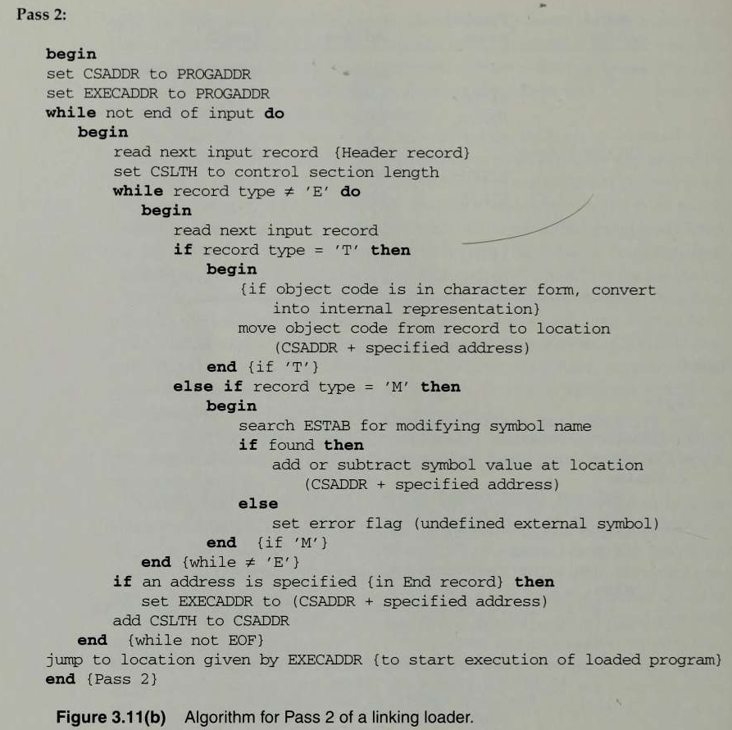

Slide 60
This algorithm can be made more efficient. Assign a reference number, which is used (instead of the symbol name) in Modification records, to each external symbol referred to in a control section. Suppose we always assign the reference number 01 to the control section name.

Slide 61
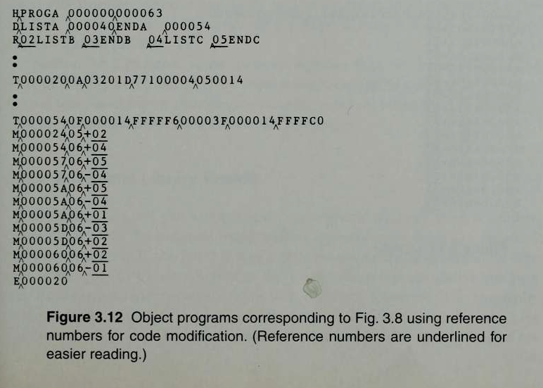

Slide 62
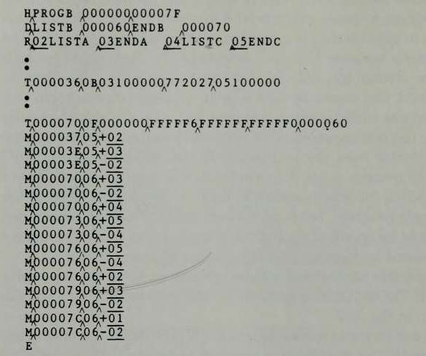

Slide 63
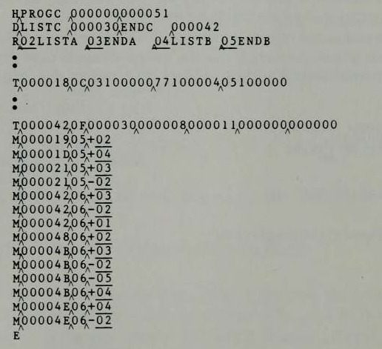

Slide 64
4.3 MACHINE-INDEPENDENT LOADER FEATURES
Loading and linking are often thought of as OS service functions.
Machine independent loader features include
the use of an automatic library search process for handling external reference and some common options that can be selected at the time of loading and linking.

Slide 65
4.3.1 Automatic Library Search
Many linking loaders can automatically incorporate routines from a subprogram library into the program being loaded
In most cases there is a standard system library for this purpose.
Other libraries may be specified by control statements or by parameters to the loader.
This feature allows the programmer to use subroutines from one or more libraries.
The subroutines called by the program being loaded are automatically fetched from the library, linked with the main program and loaded. On some systems this feature is referred to as automatic library call(or search).

Slide 66
Linking loaders that support automatic library search must keep track of
external symbols that are referred to, but not defined, in the primary input to the loader.
For this, enter symbols from each Refer record into ESTAB unless these symbols are already present.

Slide 67
These symbols are marked to indicate that symbol has not yet defined.
When the definition is seen, the address assigned to the symbol is filled in to complete the entry.
At the end of Pass 1, the symbols in ESTAB that remain undefined represent unresolved external references.
The loader searches the library or libraries specified for routines that contain the definitions of these symbols,
and processes the subroutines found by this search exactly as if they had been part of the primary input stream.

Slide 68
The subroutines fetched from a library in this way may themselves contain external references.
It is therefore necessary to repeat the library search process until all references are resolved.
If unresolved external references remain after the library search is completed, these must be treated as errors.

Slide 69
The process (above) allows the programmer to override standard subroutines in the library by supplying his or her own routines.
For example the main program refers to standard subroutine named SQRT which is automatically included in the library search function.
If the programmer wants to use a different version of SQRT, it is done by including it as input to the loader.
By the end of pass1 of the loader , SQRT would be already defined and it will not be included in any library search.

Slide 70
Libraries to be searched contains the assembled or compiled versions of the subroutines
To search these libraries, scanning the object programs for define records is quite inefficient.
A special file structure is used for libraries. This structure contains a directory that gives the name of each routine and a pointer to its address within the file.
If the subroutine is to be callable by more than one name, both names are entered into the directory but the object program is stored only once.

Slide 71
4.3.2 Loader Options
Many loaders allow the user to specify options that modify the standard processing.
Many loaders have a special command language that is used to specify options.
Sometimes there is a separate input file to the loader that contains such control statements.
The control statements can also be embedded in the primary input stream between object programs.
In other case, the programmer can include the loader control statements in the source program and the assembler or compiler retains these commands as a part of the object program.

Slide 72
Typical loader option 1:
Allows the selection of alternative sources of input.
Ex : INCLUDE program-name (library-name)
might direct the loader to read the designated object program from a library and treat it as if it were part of the primary loader input.
Loader option 2:
Allows the user to delete external symbols or entire control sections.
Ex : DELETE csect-name
might instruct the loader to delete the named control section(s) from the set of programs being loaded.
CHANGE name1, name2
might cause the external symbol name1 to be changed to name2 wherever it appears in the object programs.

Slide 73
Loader option 3:
Involves the automatic inclusion of library routines to satisfy external references.
Ex. : LIBRARY MYLIB
Such user-specified libraries are normally searched before the standard system libraries. This allows the user to use special versions of the standard routines.
NOCALL STDDEV, PLOT, CORREL
To instruct the loader that these external references are to remain unresolved.
This avoids the overhead of loading and linking the unneeded routines, and saves the memory space that would otherwise be required.

Slide 74
Another common option involves output from the loader
Eg: Through control statements the use can specify if a load map is to be printed or not and if printed, the level of details can be selected(CS names, addresses, external symbol names, addresses etc)
Another option is the ability to specify the location at which the execution is to begin(overriding any information in the object programs.
Another option is the ability to control whether or not the loader should attempt to execute the program if errors are detected during load(eg: unresolved external references)

Slide 75
4.4 LOADER DESIGN OPTIONS
Linking loaders perform all linking and relocation at load time. A linking loader performs all linking and relocation operations, including automatic library search if specified, and loads the linked program directly into memory for execution.
There are two alternatives:
1. Linkage editors, which perform linking prior to load time. A linkage editor produces a linked version of the program (load module or executable image), which is written to a file or library for later execution.
2. Dynamic linking, in which the linking function is performed at execution time.
Precondition: The source program is first assembled or compiled, producing an object program.

Slide 76
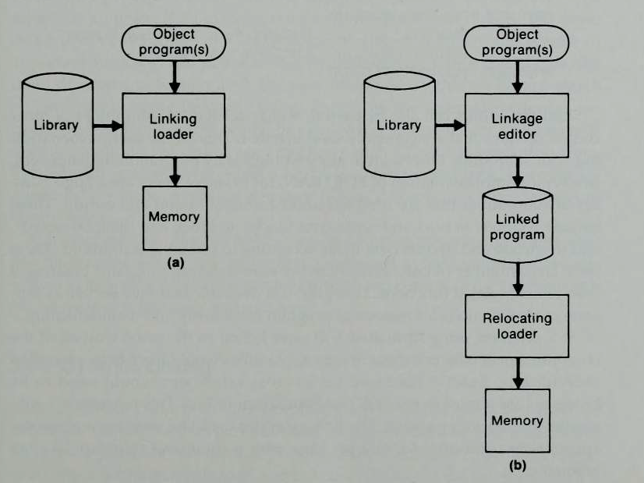
4.4.1 Linkage Editors
Processing of an object program using (a) Linking loader (b) Linkage editor

Slide 77
4.4.1 Linkage Editors
A linkage editor produces a linked version of the program (load module or executable image), which is written to a file or library for later execution.
When the user is ready to run the linked program, a simple relocating loader can be used to load the program into memory.
The only object code modification necessary is the addition of an actual load address to relative values within the program.
The linkage editor performs relocation of all control sections relative to the start of the linked program. Thus, all items that need to be modified at load time have values that are relative to the start of the linked program.
This means that the loading can be accomplished in one pass with no external symbol table required.
This involves much less overhead than using a linking loader.

Slide 78
If a program is to be executed many times without being reassembled, the use of a linkage editor substantially reduces the overhead required.
Resolution of external references and library searching are performed only once(when the program is link edited). In contrast a linking loader searches libraries and resolves external references every time the program is executed.
In certain situations such as program development and testing, the program is reassembled for every execution. In certain situation when a program is not used frequently, the linked version of the program to be stored is not worthwhile. In the above cases, a linking loader is used which avoids the steps of writing and reading the linked program.
In linkage editor, even after linking the information concerning external references is retained because if this is not retained the program cannot be reprocessed by the linkage editor; it can only be loaded and executed.

Slide 79
Linkage editors can perform many useful functions besides simply preparing an object program for execution.
Eg., A progam named PLANNER has a subroutine named PROJECT which is to be changed for some reason. After the new version of PROJECT is assembled, the linkage editor replace the old version with the updated version of PLANNER as follows:
INCLUDE PLANNER (PROGLIB)
DELETE PROJECT {delete from existing PLANNER}
INCLUDE PROJECT (NEWLIB) {include new version}
REPLACE PLANNER (PROGLIB)

Slide 80
Linkage editors can also be used to build packages of subroutines or other control sections that are generally used together. This can be useful when dealing with subroutine libraries that support high-level programming languages.
Linkage editors often include a variety of other options and commands like those discussed for linking loaders.
Compared to linking loaders, linkage editors in general tend to offer more flexibility and control.

Slide 81
4.4.2 Dynamic Linking
Linkage editors perform linking operations before the program is loaded for execution.
Linking loaders perform these same operations at load time.
Dynamic linking, dynamic loading, or load on call postpones the linking function until execution time: a subroutine is loaded and linked to the rest of the program when it is first called.
Dynamic linking is often used to allow several executing programs to share one copy of a subroutine or library, eg: run-time support routines for a high-level language like C.
Dynamic linking provides the ability to load the routines only when they are needed.
If the subroutines involved are large or have many external references, this can result in substantial savings of time and memory space.

Slide 82
With a program that allows its user to interactively call any of the subroutines of a large mathematical and statistical library, all of the library subroutines could potentially be needed, but only a few will actually be used in any one execution.
Dynamic linking can avoid the necessity of loading the entire library for each execution except those necessary subroutines.
Figure illustrates a method in which routines that are to be dynamically loaded must be called via an operating system service request. This method could also be thought of as a request to a part of the loader that is kept in memory during execution of the program.

Slide 83
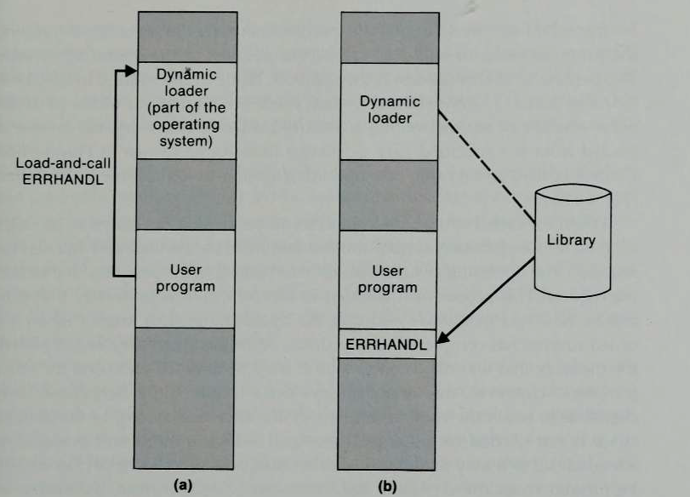

Slide 84
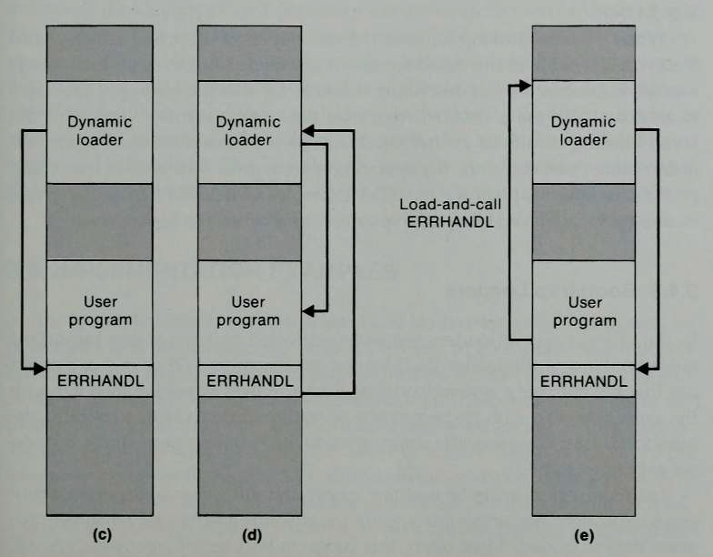

Slide 85
Fig (a): Instead of executing a JSUB instruction referring to an external symbol, the program makes a load-and-call service request to OS. The parameter of this request is the symbolic name of the routine to be called.
Fig (b): OS examines its internal tables to determine whether or not the routine is already loaded. If necessary, the routine is loaded from the specified user or system libraries.
Fig (c): Control is then passed from OS to the routine being called
Fig (d): When the called subroutine completes it processing, it returns to its caller (i.e.,OS). OS then returns control to the program that issued the request.
Fig (e): If a subroutine is still in memory, a second call to it may not require another load operation. Control may simply be passed from the dynamic loader to the called routine.

Slide 86
4.4.3 Bootstrap Loaders
With the machine empty and idle there is no need for program relocation.
We can specify the absolute address for whatever program is first loaded and this will be the OS, which occupies a predefined location in memory.
This means that we need some means of accomplishing the functions of an absolute loader.
1. To have the operator enter into memory the object code for an absolute loader, using switches on the computer console. However the process is much too inconvenient and error – prone to be a good solution to the problem
2. To have the absolute loader program permanently resident in a ROM. When some hardware signal(pressing a start switch) occurs, the machine begins to execute this ROM program. On some computers, the program is executed directly in the ROM: on others, the program is copied from ROM to main memory and executed there. Modification to the absolute program cannot be done since it is in ROM.

Slide 87
3. To have a built –in hardware function that reads a fixed –length record from some device into memory at a fixed location.
The particular device to be used can often be selected via console switches. After the read operation is complete, control is automatically transferred to the address in memory where the record was stored. This record contains machine instructions that load the absolute program that follows.
If the loading process requires more instructions that can be read in a single record, this first record causes the reading of others, and these in turn can cause the reading of still more records – hence the term boots trap.
The first record(or records) is generally referred to as bootstrap loader:· Such a loader is added to the beginning of all object programs that are to be loaded into an empty and idle system.
This includes the OS itself and all stand-alone programs that are to be run without an OS.

